Slide 1
PAMOJA DOKITA –BLOOD BANK USER GUIDE

Slide 2
OBJECTIVES
CREATING NEW DONORS
MANAGING DONOR RECORDS
SCREENING PROCESS
ADDING BLOOD UNITS
TRACKING STORAGE CONDITIONS
EXPORTING BLOOD BAGS IN AND OUT OF DIFFERENT HOSPITALS
RECEIVING AND PROCESSING REQUESTS
MATCHING DONOR BLOOD TYPE
ISSUING BLOOD UNITS
GENERATING REPORTS
FINANCIAL TRACEABILITY

Slide 3
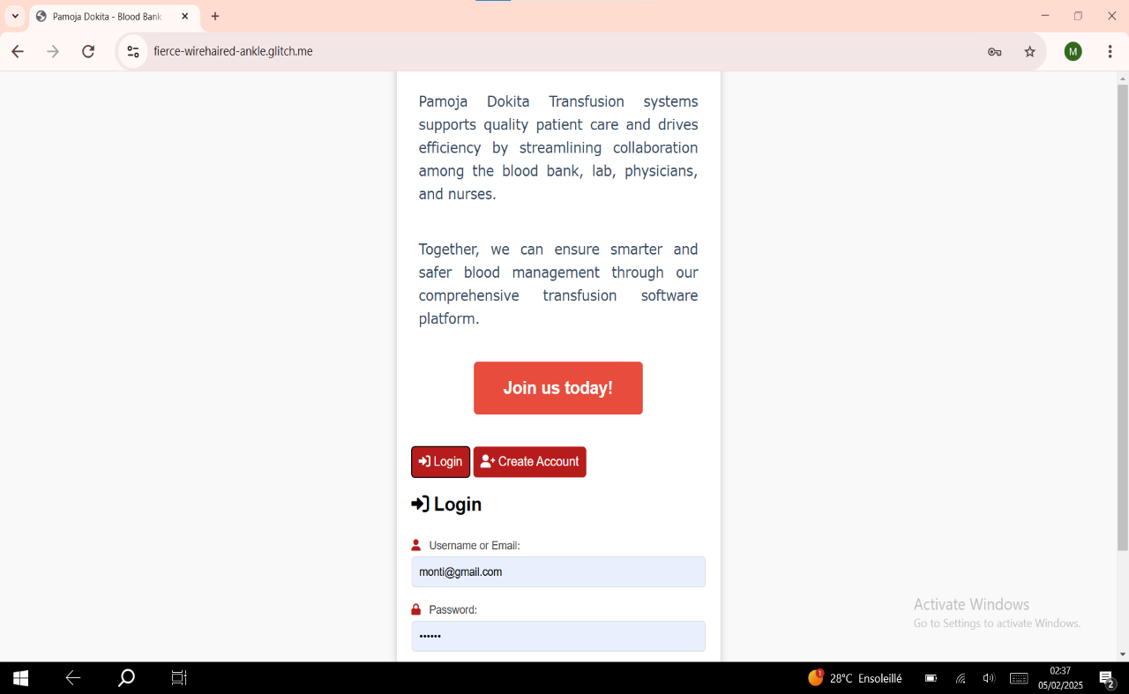
HOW TO LOG INTO BLOOD BANK SYSTEM
1
2
1- Log in with username or email and password
2- Create account for first time users

Slide 4
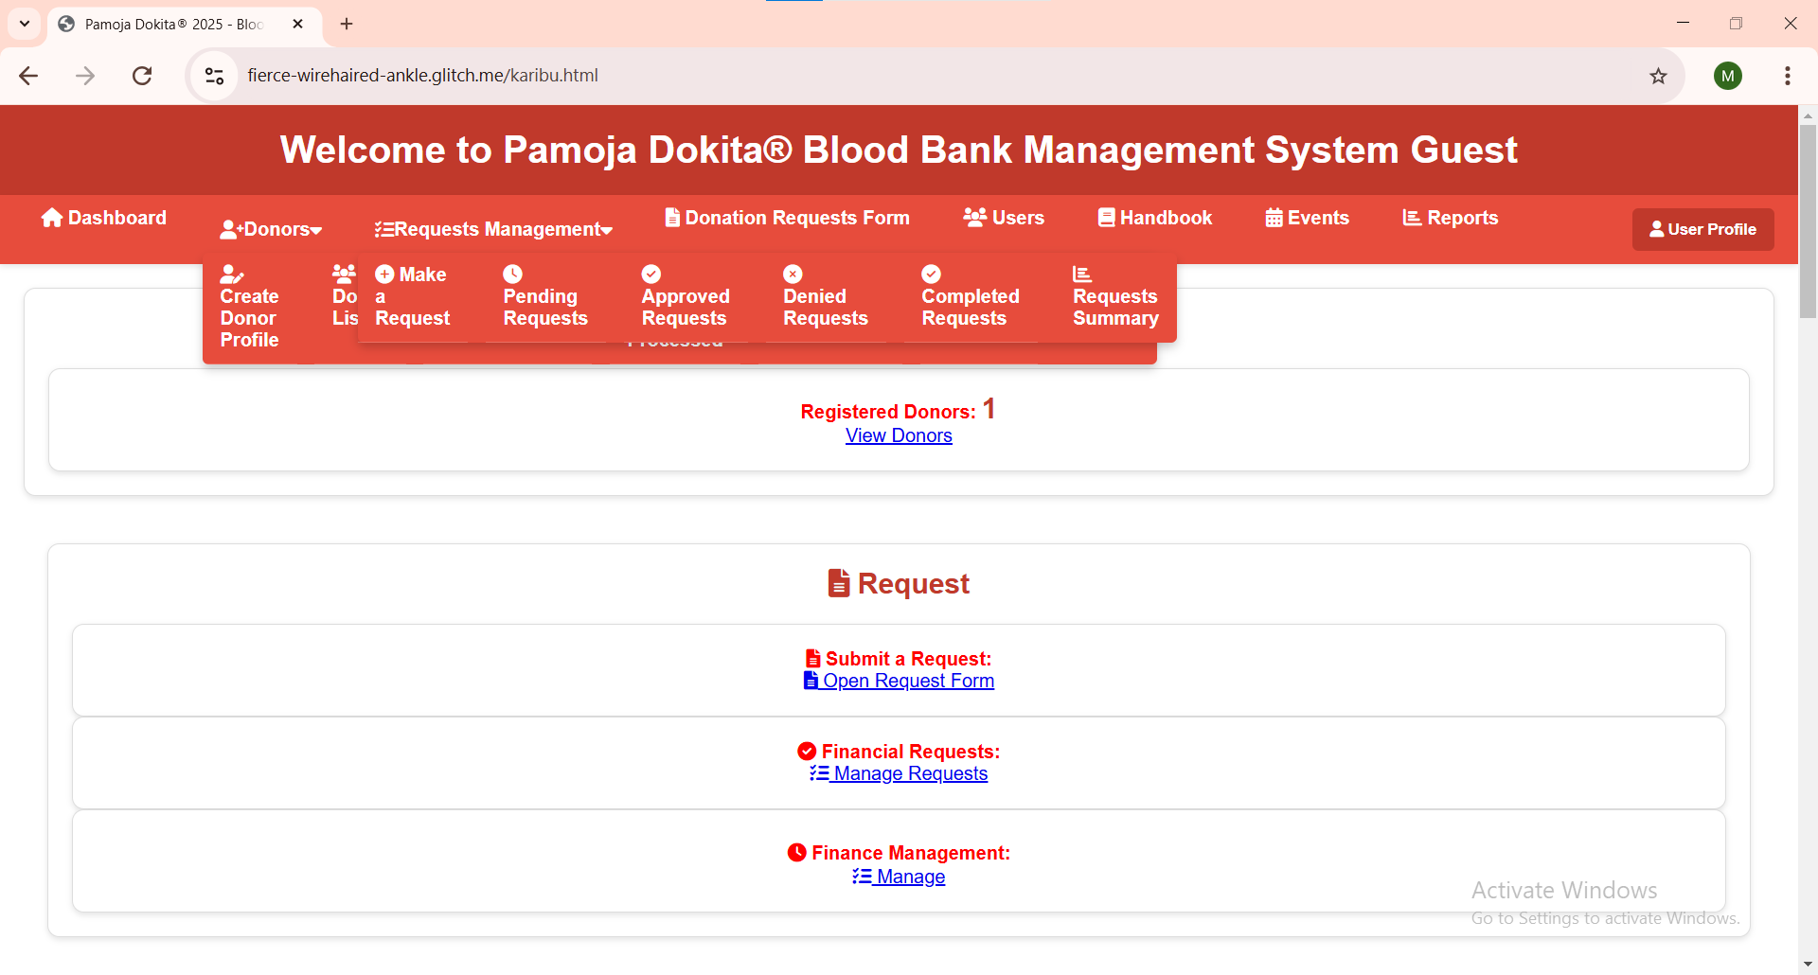
DASHBOARD

Slide 5
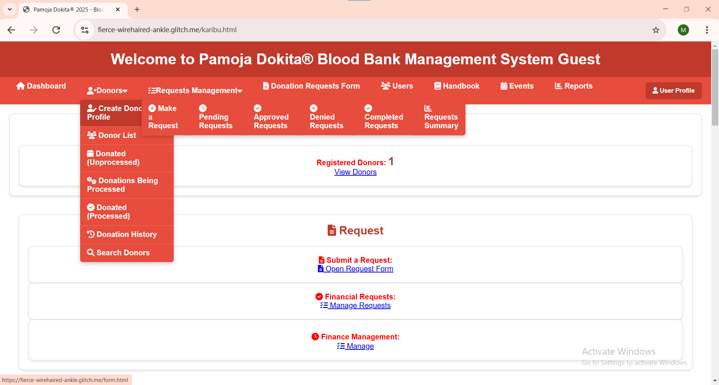
How to create a new donor
A
B
C
D
E
F
G

Slide 6
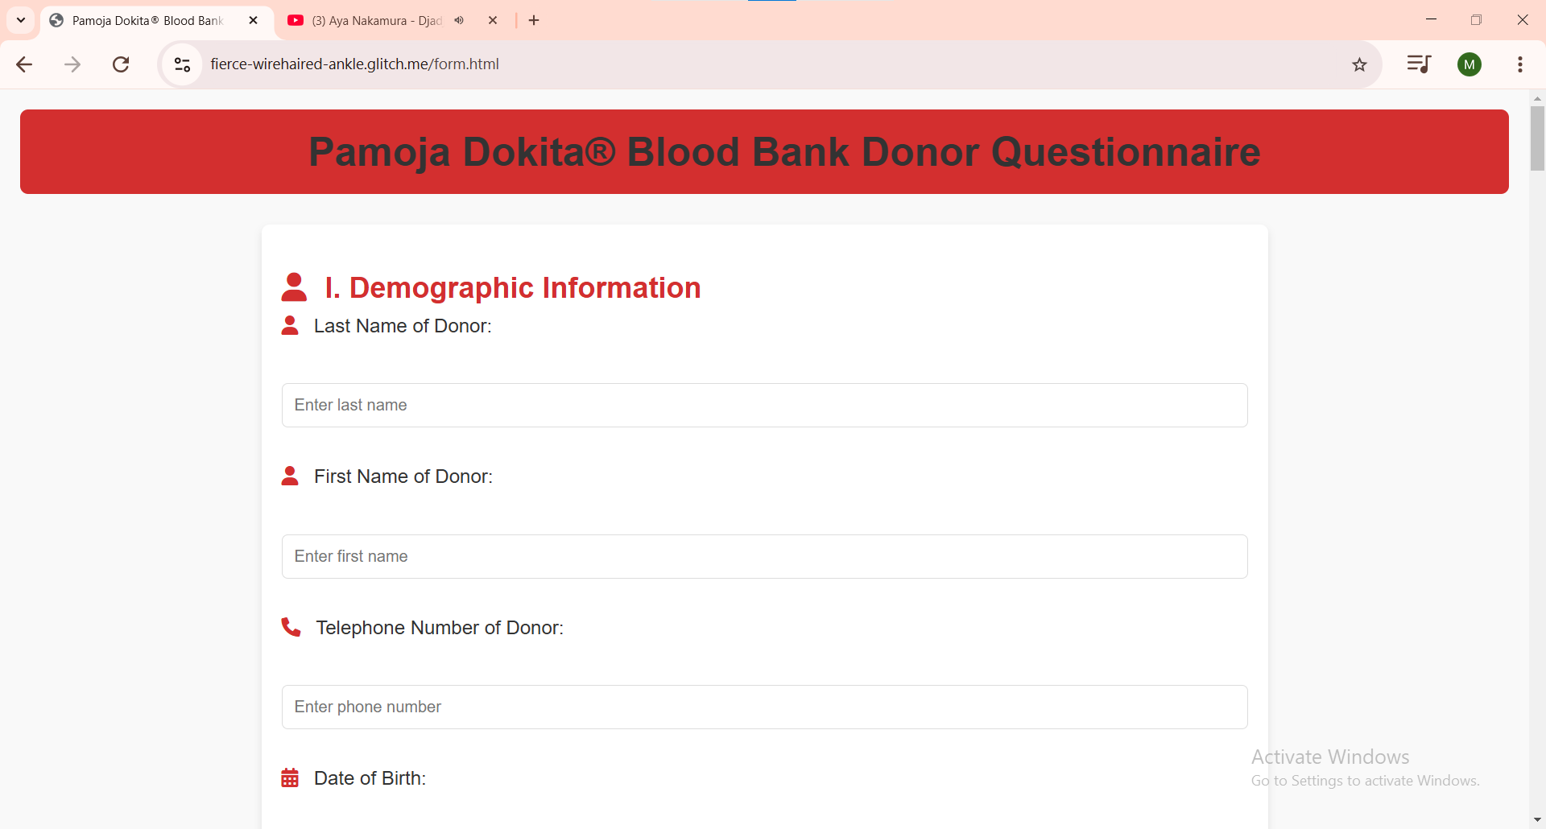
A
Enter donors demographic Information and medical history

Slide 7
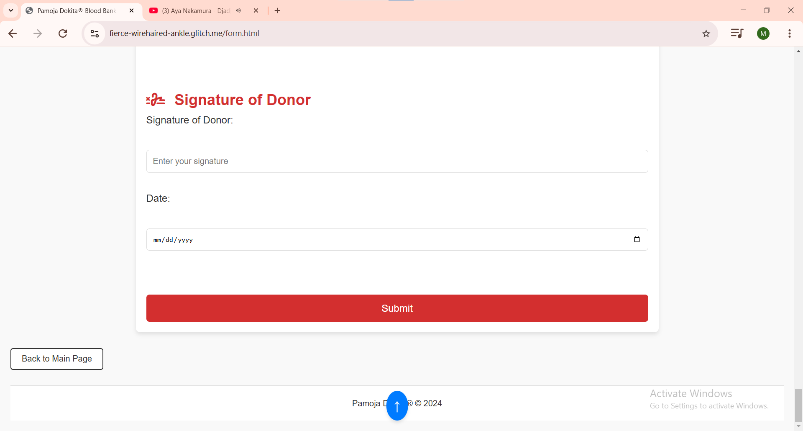
Sign and Submit medical questionnaire

Slide 8
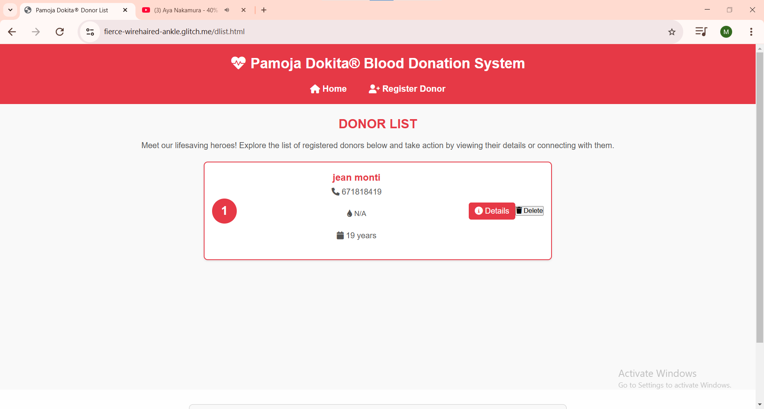
B
View list of total number of registered donors including their details

Slide 9
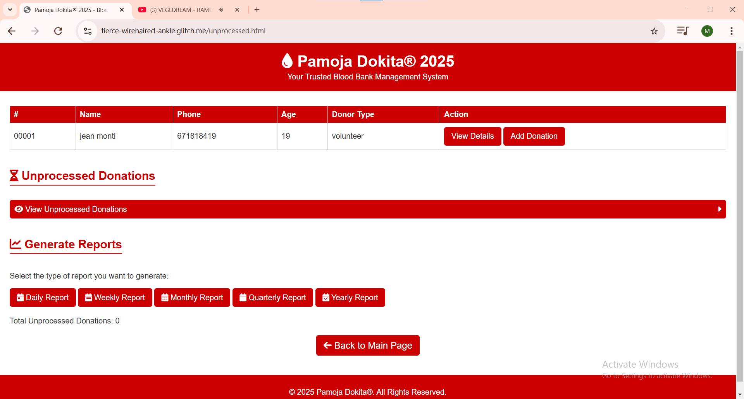
c
1
2
3
1- click on view details to view donor demographic
2-click on add donation to proceed with blood procession
3-View reports daily, weekly, monthly etc..

Slide 10
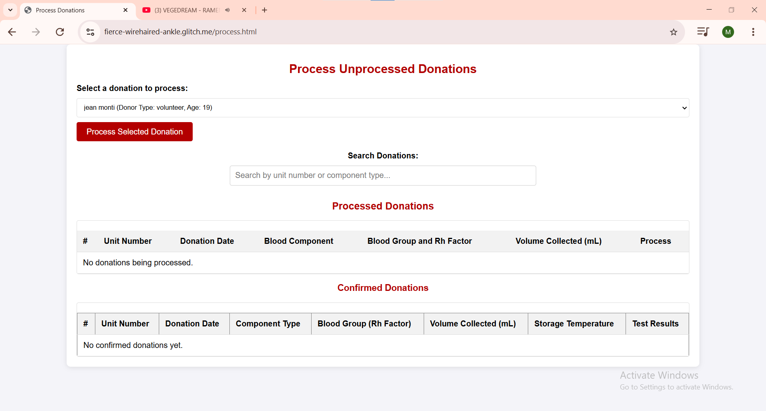
D
1
3
2
1- search donors name
2- serach donations by unit number generated in page above
3-click on process selected to continue with blood procession

Slide 11
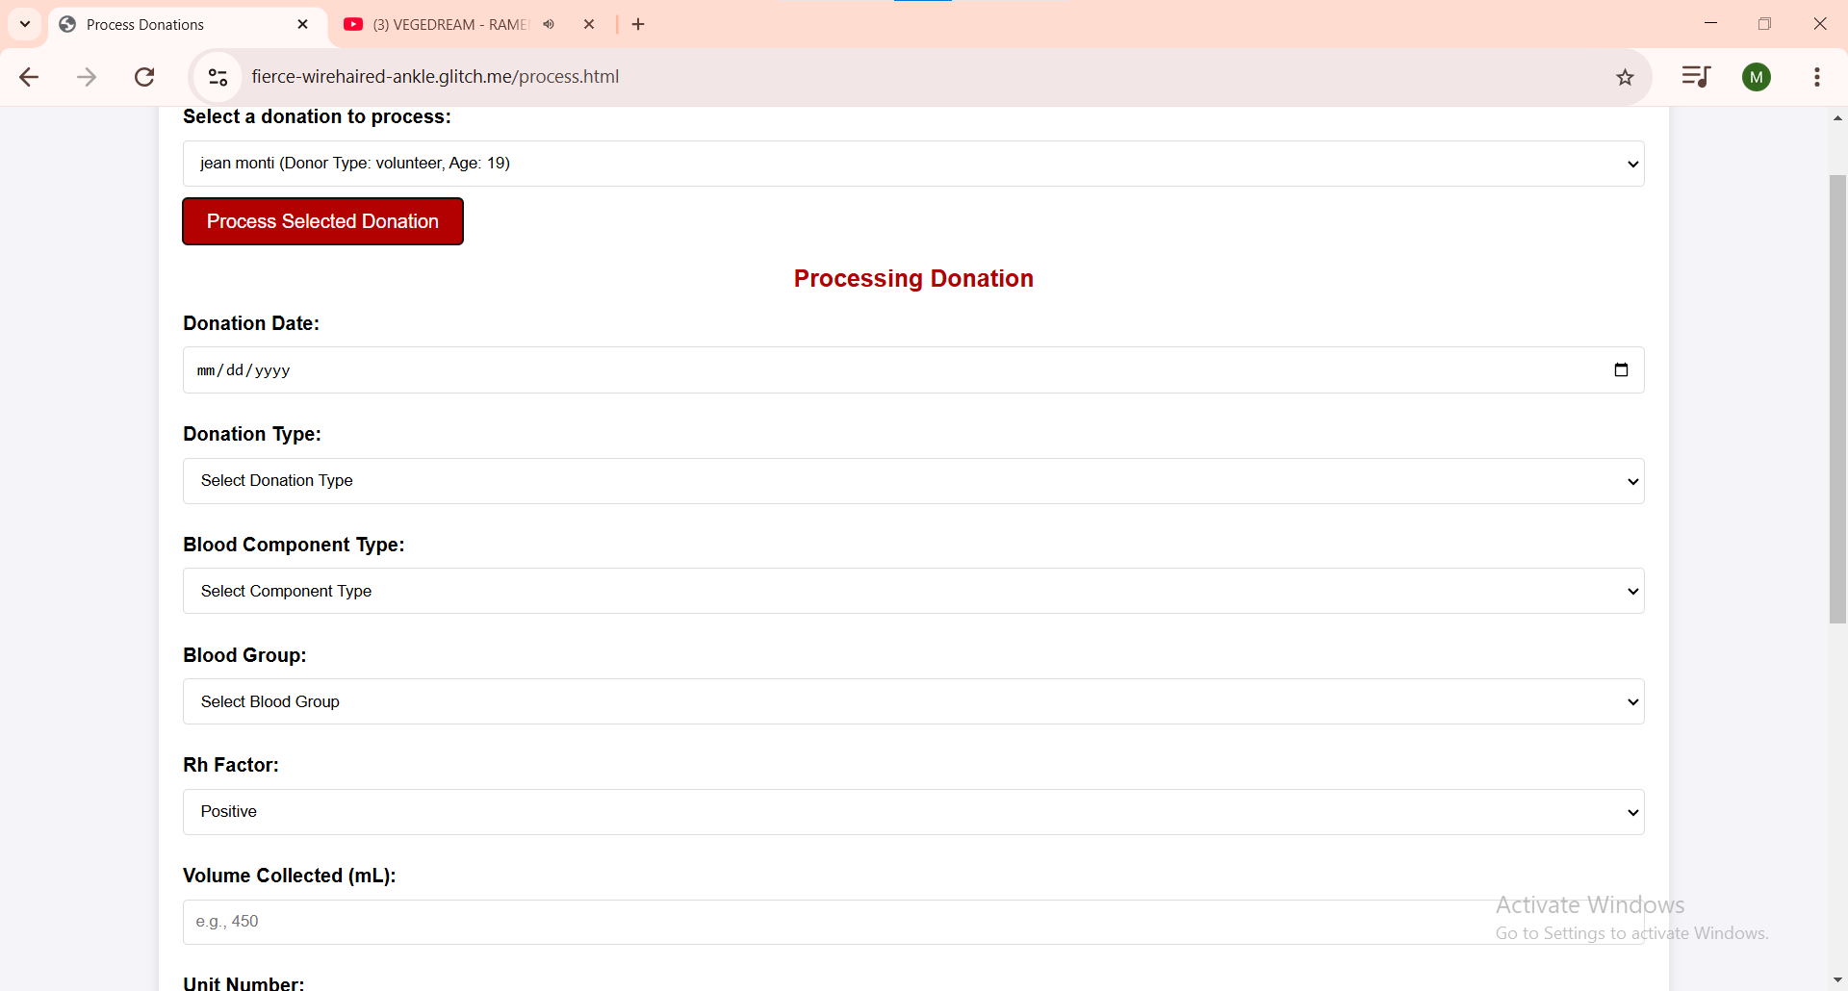
1
1- Fill in required information

Slide 12
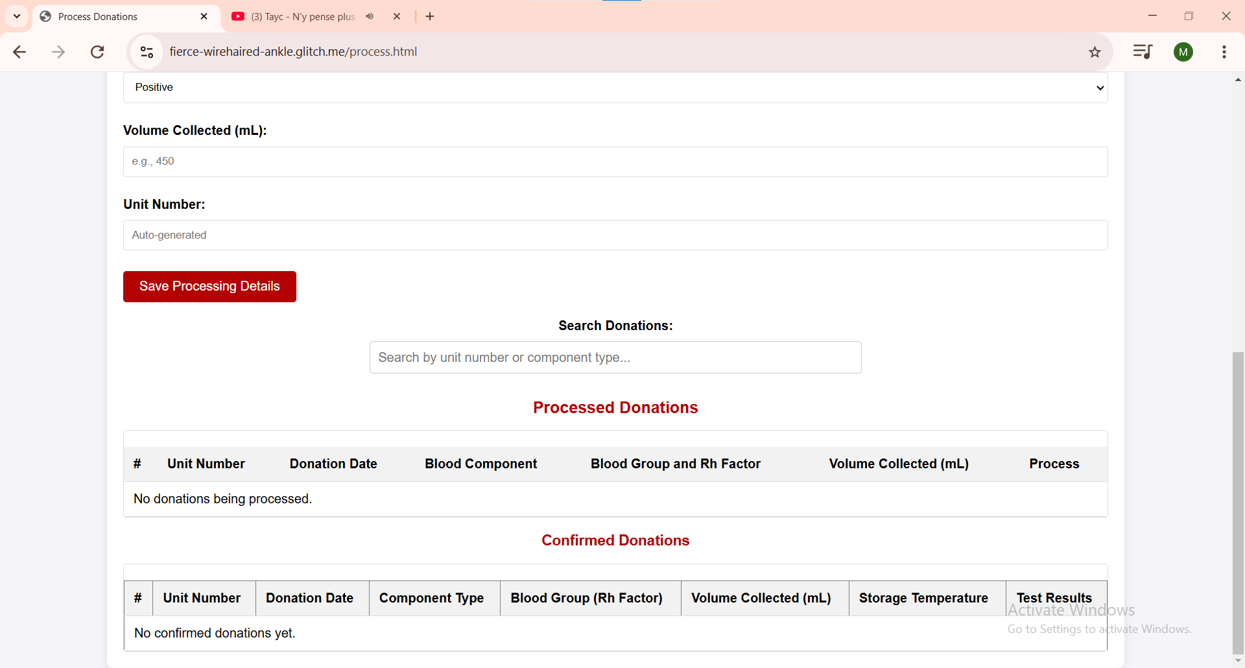
1
1- Save taken details

Slide 13
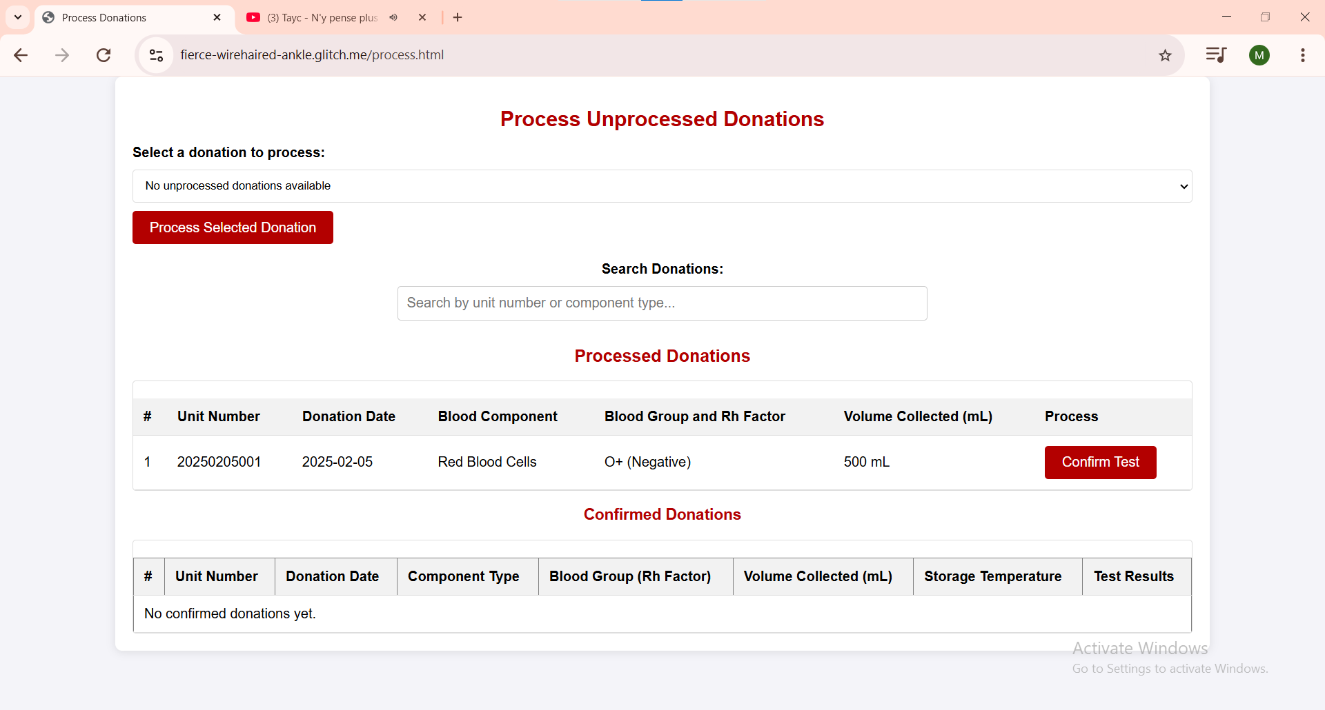
1
1- Click on confirm test to validate next test results

Slide 14
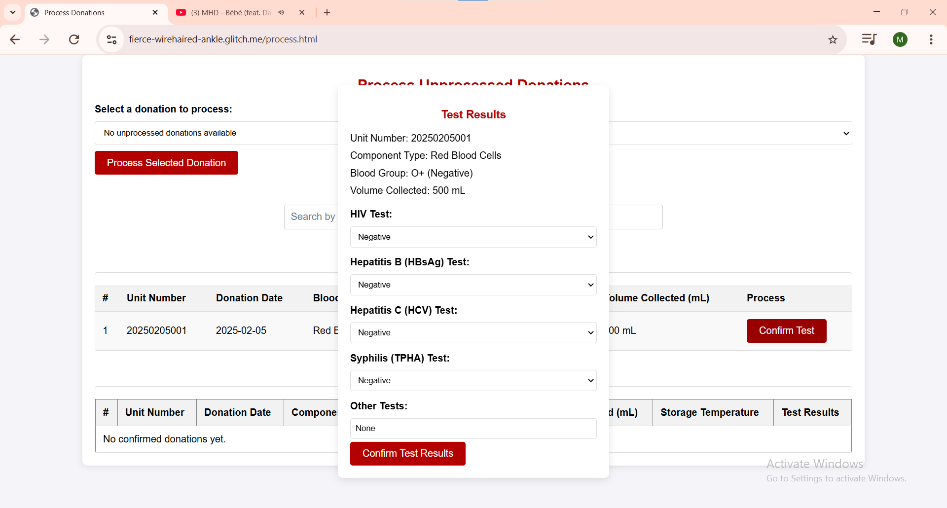
1
1- validate test results by clicking on Confirm Test Results

Slide 15
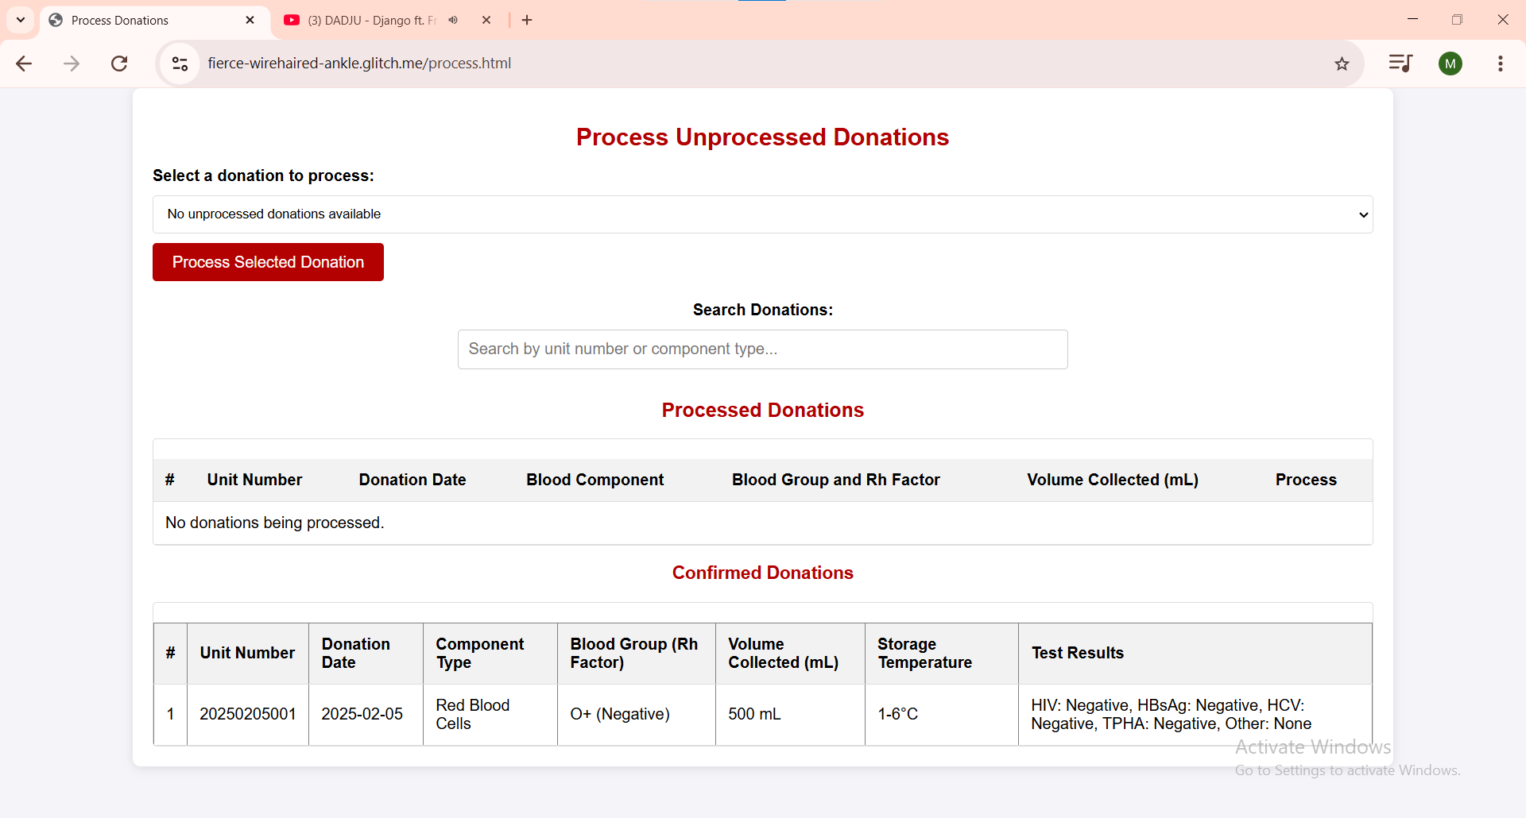
1
1-List of confirmed lab results

Slide 16
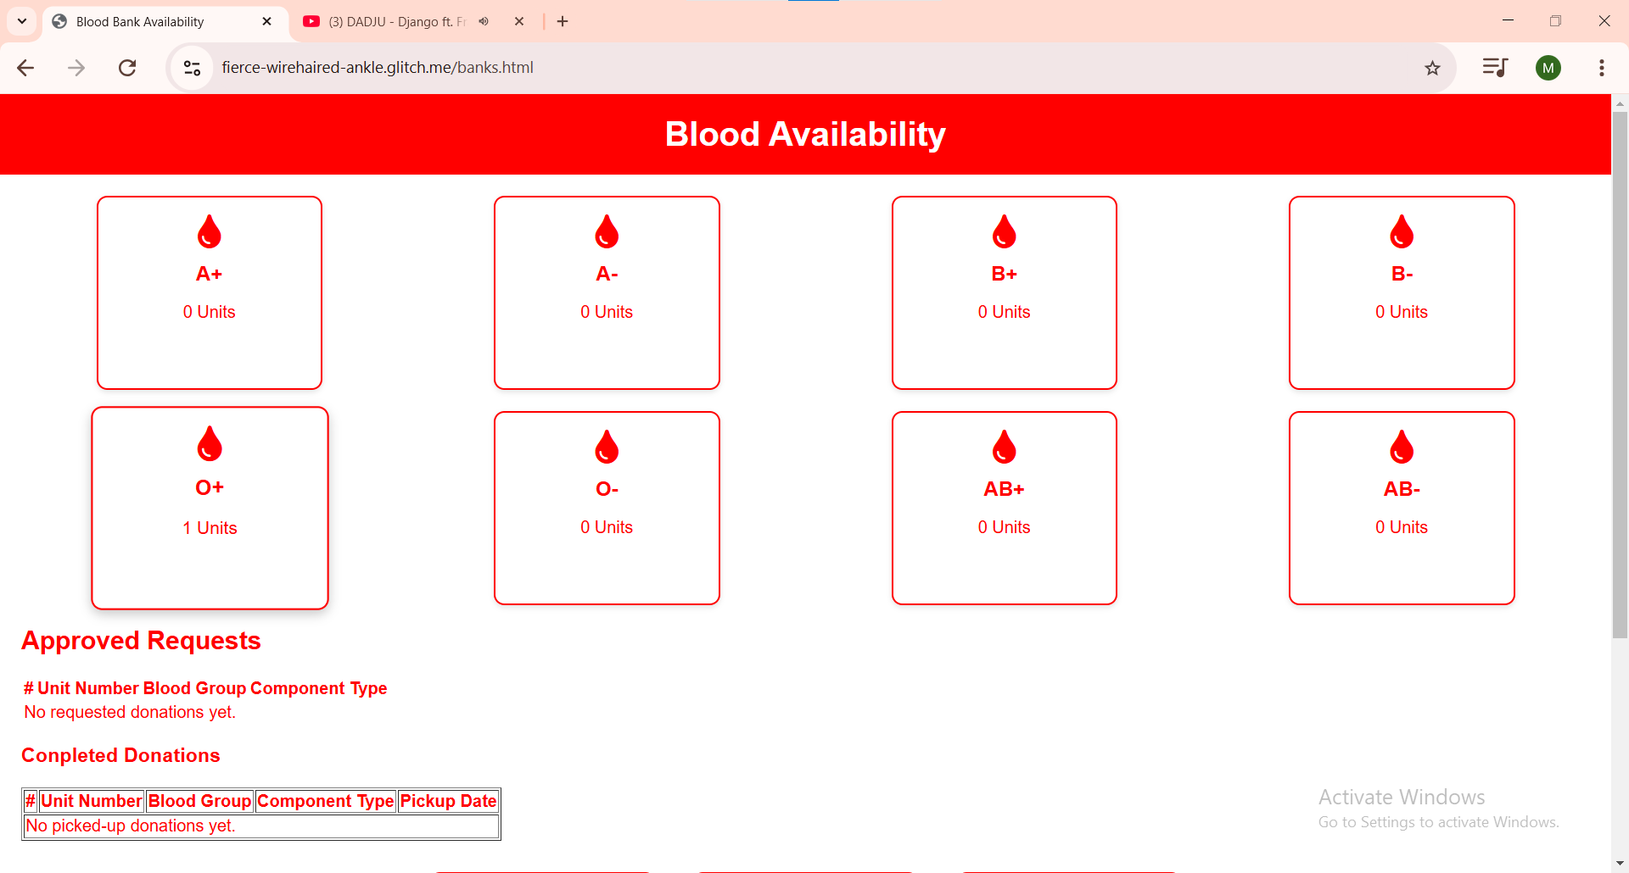
E
1
1- Blood type availability e.g [O+ 1bloog bag available].

Slide 17
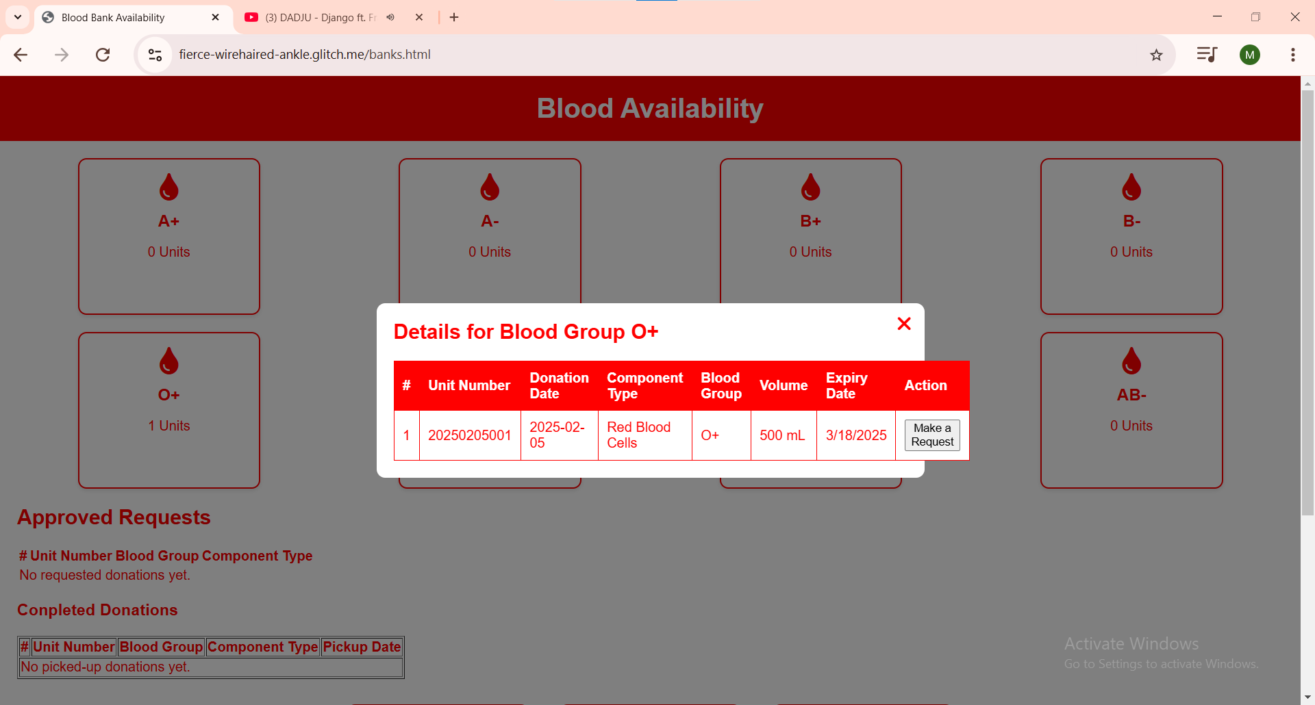
1
1- Make a request for a potential recipient

Slide 18
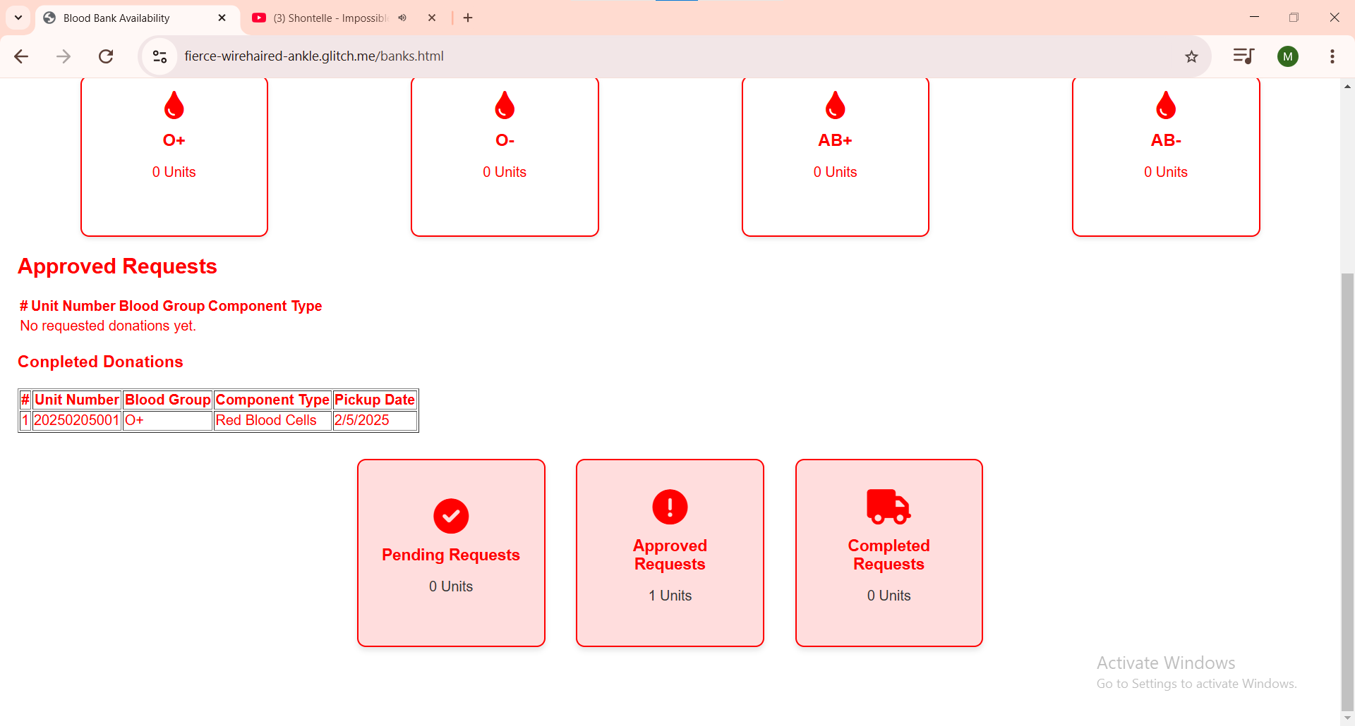
1- Boxes to indicate pending, approved, or completed requests
1

Slide 19
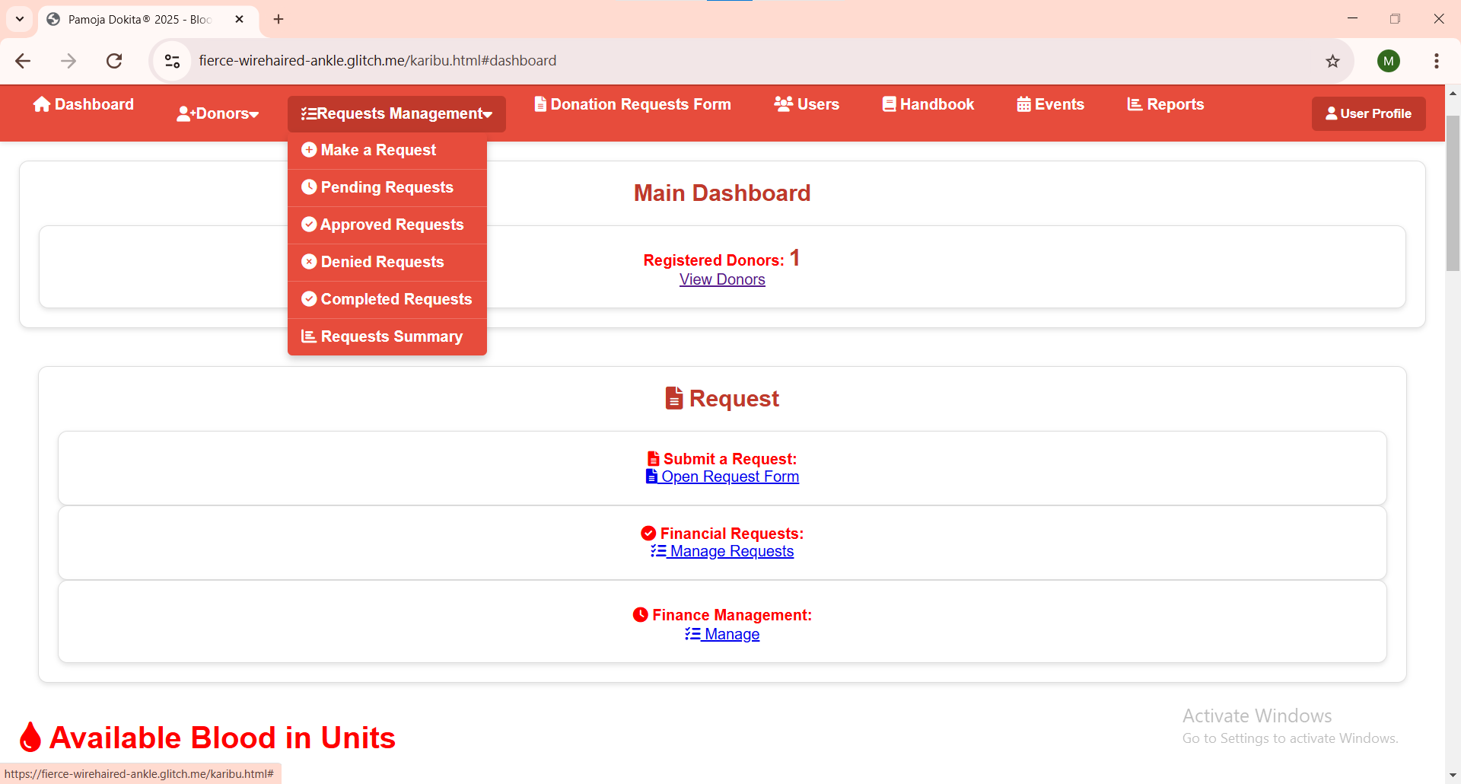
MAKE A BLOOD REQUEST FROM ANOTHER HOSPITAL OR CLINIC
H
I
J
K
L
M

Slide 20
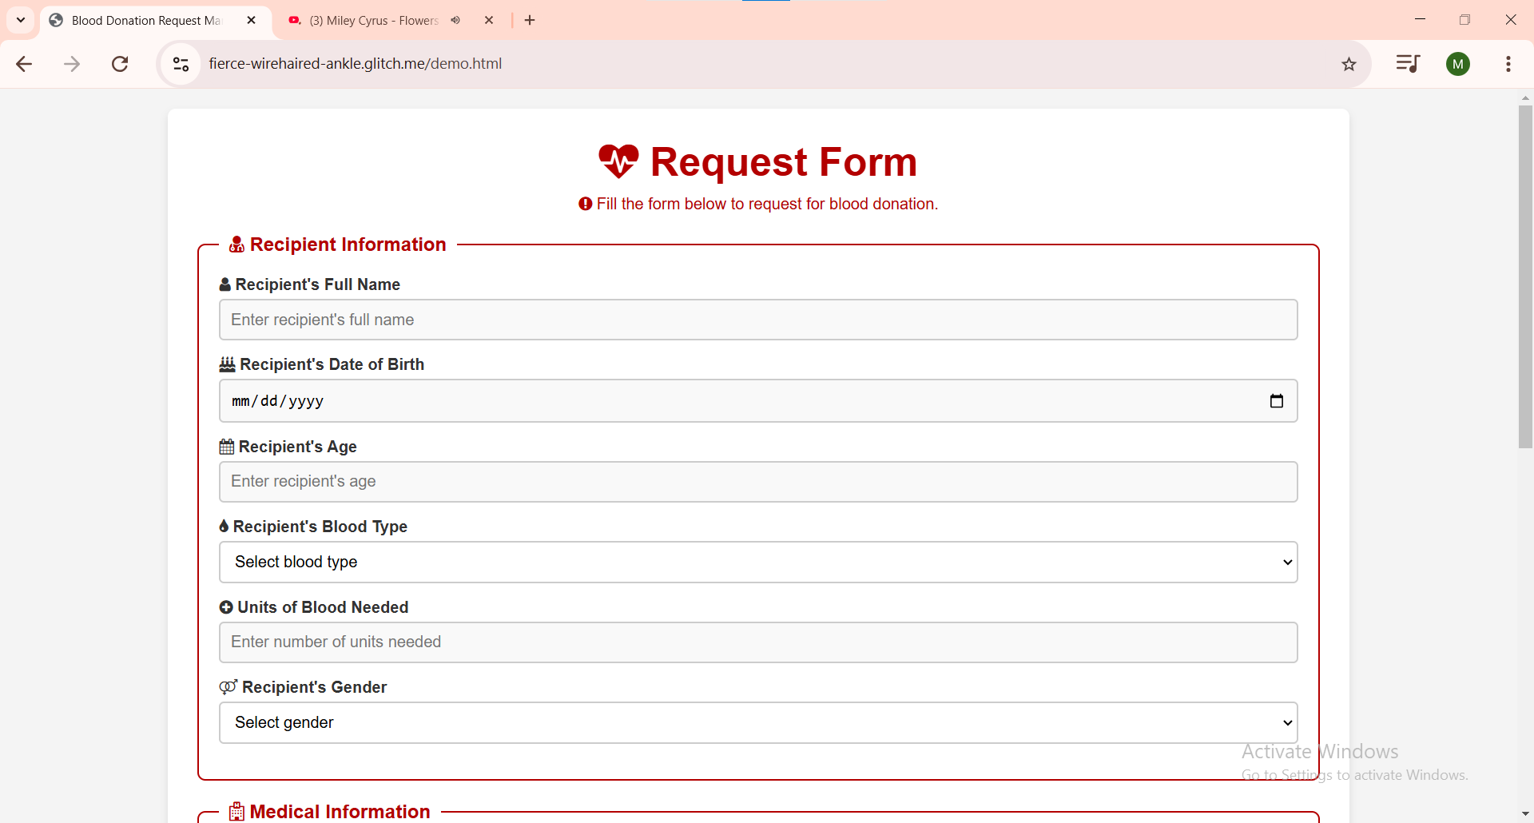
H
1
1- Fill in recipients information

Slide 21
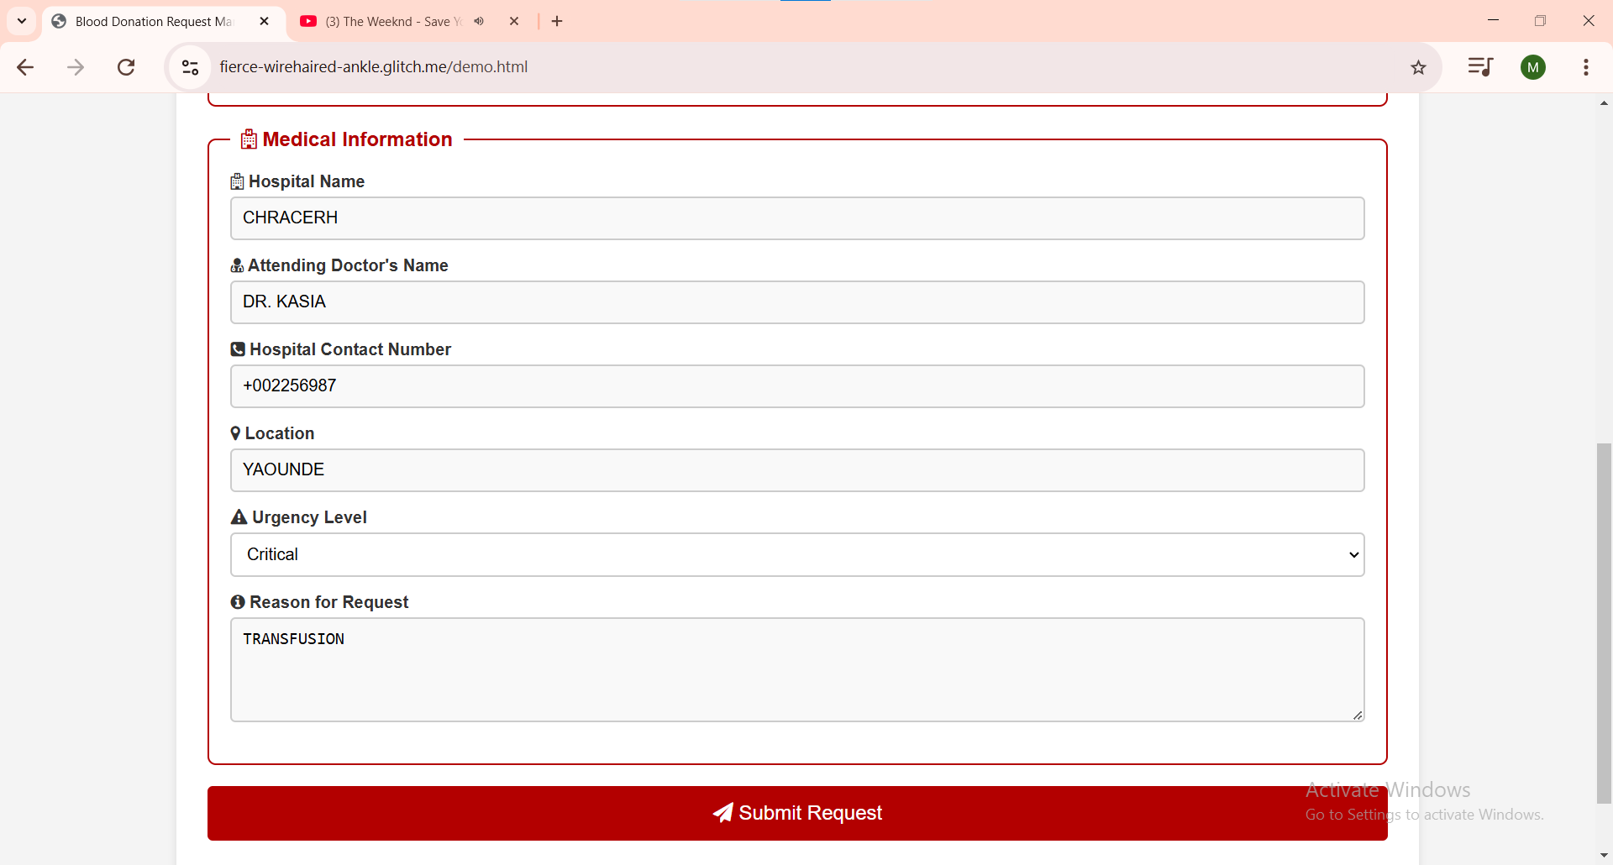
1
2
1- Fill up hospitals information
2- submit request

Slide 22
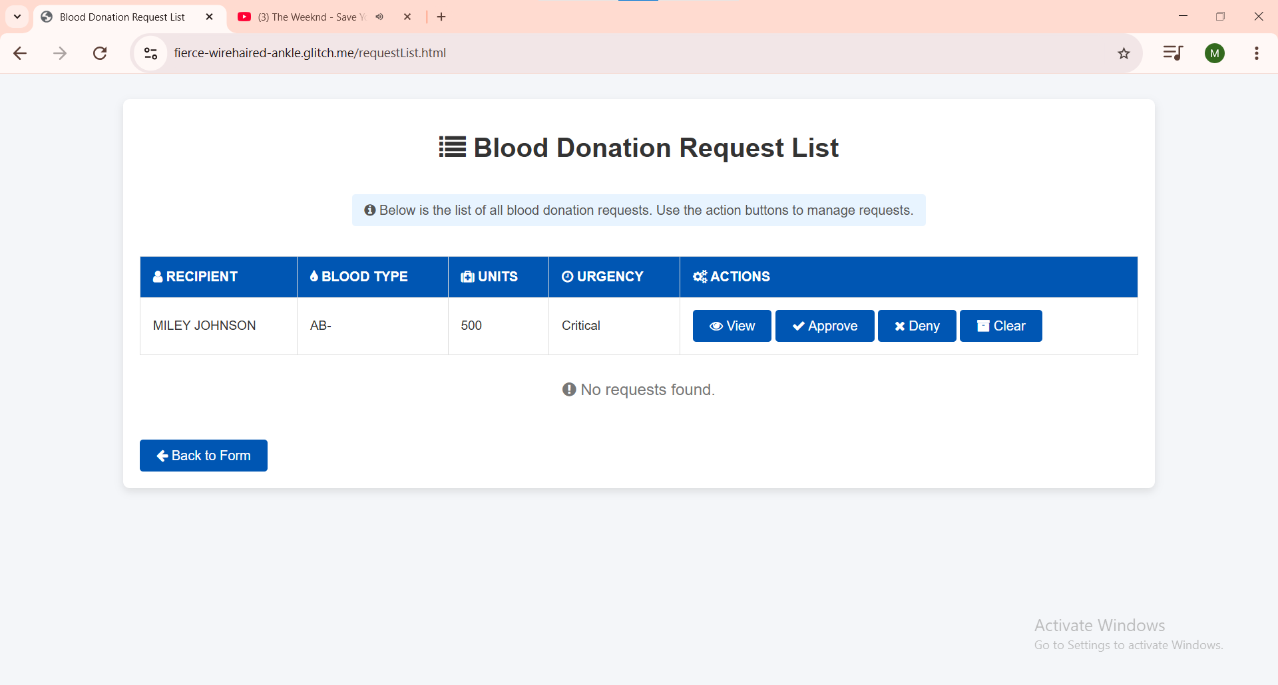
I
1
2
3
4
1- View recipients details
2- Approve pending request
3-Deny pending request
4- Delete pending request

Slide 23
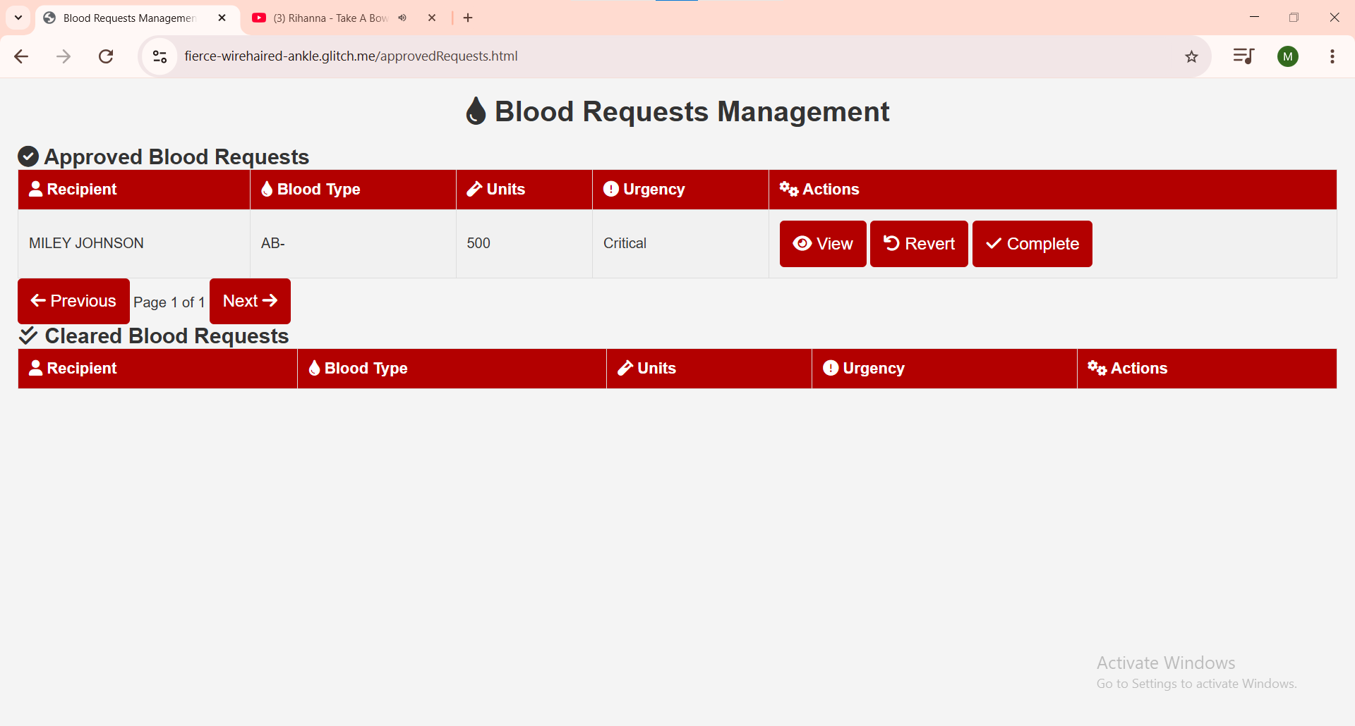
J
1
2
1- Revert back to pending request if there be any complications or shortage in blood bag
2- Click on complete for final approval

Slide 24
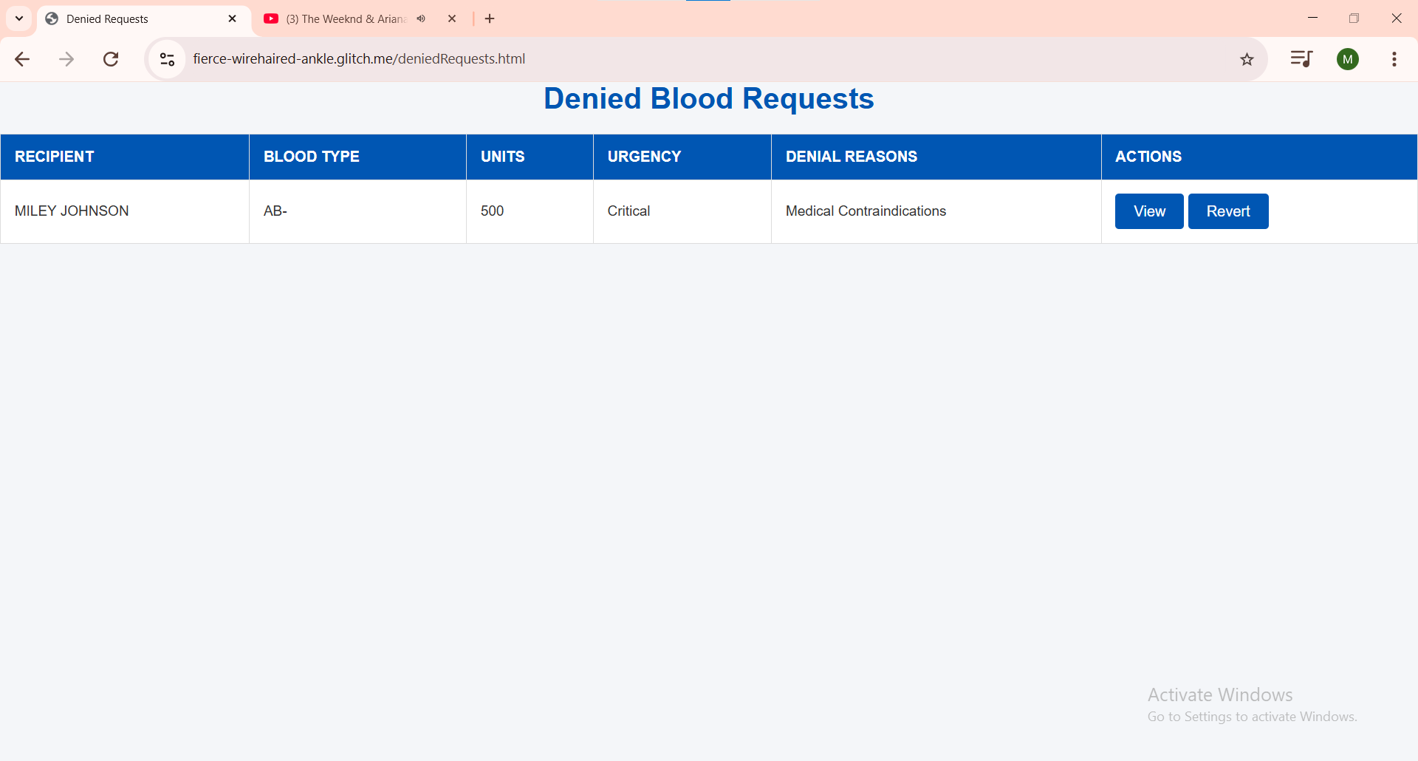
K
1
1- Revert back to pending request in case of blood availability, or match etc…

Slide 25
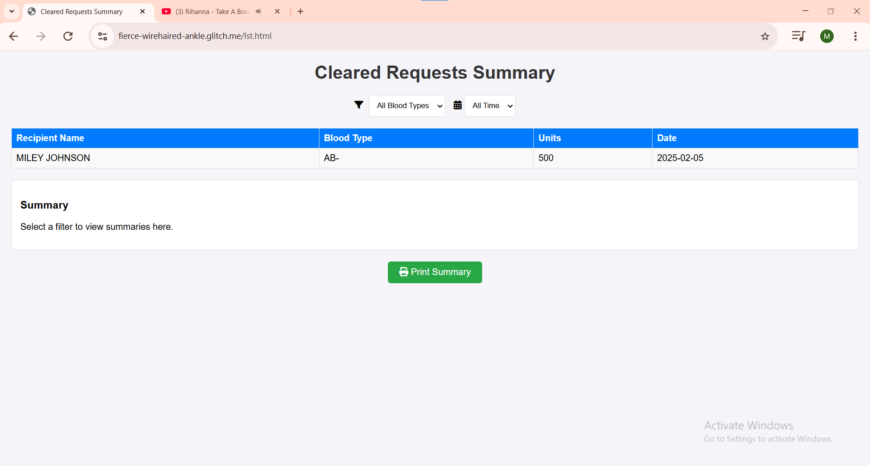
M
1
1- Print summary list of donations

